Slide 1





ADVANCED STATISTIC AND PROBILITY
MRS. LODILYN DOMETITA MOGOL, LPT, MAT MATHEMATICS

Slide 2

COLLEGE OF TEACHER EDUCATION
INTRODUCTION TO PROBABILITY
ADVANCED STATISTICS AND PROBABILITY
LODILYN D. MOGOL LPT. MAT MATH (CAR)

Slide 3
COLLEGE OF TEACHER EDUCATION
Sample Spaces and Events
Basic Terminology and Probability Rules
An event is something that occurs, or happens.
-For example, flipping a coin is an event, and so is walking in the park and passing by a bench. Anything that could possibly happen is an event.
ADVANCED STATISTICS AND PROBABILITY
LODILYN D. MOGOL LPT. MAT MATH (CAR)

Slide 4
COLLEGE OF TEACHER EDUCATION
Suppose a coin is tossed once. There are two possible outcomes, either heads, H, or tails, T. Notice that if the experiment is conducted only once, you will observe only one of the two possible outcomes.
An experiment is the process of taking a measurement or making an observation.
These individual outcomes for an experiment are each called simple events.
ADVANCED STATISTICS AND PROBABILITY
LODILYN D. MOGOL LPT. MAT MATH (CAR)

Slide 5
COLLEGE OF TEACHER EDUCATION
A die has six possible outcomes: 1, 2, 3, 4, 5, or 6. When we toss it once, only one of the six outcomes of this experiment will occur. The one that does occur is called a simple event.
ADVANCED STATISTICS AND PROBABILITY
LODILYN D. MOGOL LPT. MAT MATH (CAR)

Slide 6
COLLEGE OF TEACHER EDUCATION
The sample space is the set of all possible outcomes of an experiment, or the collection of all the possible simple events of an experiment.
We will denote a sample space by S. As we know, there are 6 possible outcomes for throwing a die. We may get 1, 2, 3, 4, 5, or 6, so we write the sample space as the set of all possible outcomes:
S = {1,2,3,4,5,6}
Similarly, the sample space of tossing a coin is either heads, H, or tails, T, so we write S={H,T}.
ADVANCED STATISTICS AND PROBABILITY
LODILYN D. MOGOL LPT. MAT MATH (CAR)

Slide 7
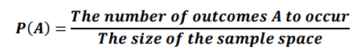
COLLEGE OF TEACHER EDUCATION
Probability is usually denoted by P, and the respective elements of the sample space (the outcomes) are denoted by A,B,C, etc.
The mathematical notation that indicates the probability that an outcome, A, happens is P(A). We use the following formula to calculate the probability of an outcome occurring:
ADVANCED STATISTICS AND PROBABILITY
LODILYN D. MOGOL LPT. MAT MATH (CAR)

Slide 8
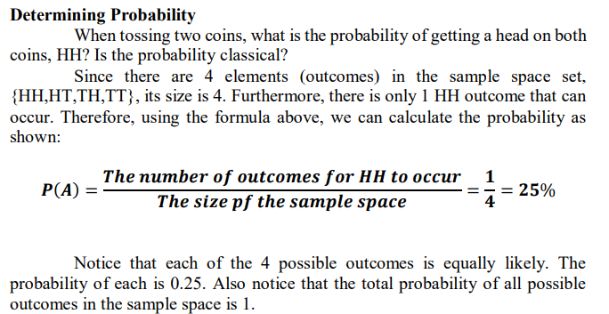
COLLEGE OF TEACHER EDUCATION
ADVANCED STATISTICS AND PROBABILITY
LODILYN D. MOGOL LPT. MAT MATH (CAR)

Slide 9
COLLEGE OF TEACHER EDUCATION
Operations with Sets
Union and Intersection
The union of events A and B occurs if either event A, event B, or both occur in a single performance of an experiment.
We denote the union of the two events by the symbol A∪B. You read this as either “A union B” or “A or B.” A∪B means everything that is in set A or in set B or in both sets.
ADVANCED STATISTICS AND PROBABILITY
LODILYN D. MOGOL LPT. MAT MATH (CAR)

Slide 10
COLLEGE OF TEACHER EDUCATION
The intersection of events A and B occurs if both event A and event B occur in a single performance of an experiment.
It is where the two events overlap. We denote the intersection of two events by the symbol A∩B. You read this as either “A intersection B” or “A and B.” A∩B means everything that is in set A and in set B.
That is, when looking at the intersection of two sets, we are looking for where the sets overlap.
ADVANCED STATISTICS AND PROBABILITY
LODILYN D. MOGOL LPT. MAT MATH (CAR)

Slide 11
COLLEGE OF TEACHER EDUCATION
Describing and Finding the Probabilities of Unions and Intersections Suppose you have a standard deck of 52 cards.
Let:
A: draw a 5
B:draw a Jack
1. Describe A∪B for this experiment, and find the probability, P, of A∪B.
ADVANCED STATISTICS AND PROBABILITY
LODILYN D. MOGOL LPT. MAT MATH (CAR)

Slide 12
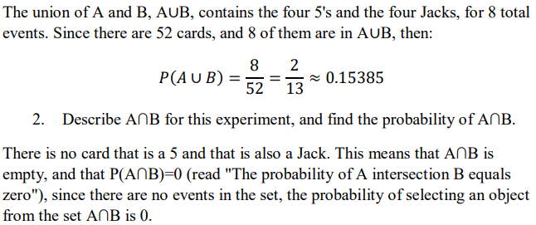
COLLEGE OF TEACHER EDUCATION
ADVANCED STATISTICS AND PROBABILITY
LODILYN D. MOGOL LPT. MAT MATH (CAR)

Slide 13
SENIOR HIGH SCHOOL DEPARTMENT
Counting Techniques
Probability is primarily concerned with predicting chances, especially the occurrence of an event
Any probability activity, called an experiment, gives results which are known as outcomes.
Tree diagram – is a graphic organizer that makes use of branching connecting lines to represent a certain relationship between events.
STATISTICS AND PROBABILITY
LODILYN D. MOGOL LPT. MAT MATH (CAR)

Slide 14
SENIOR HIGH SCHOOL DEPARTMENT
Example no. 1
You are driving down McArthur Highway where you encounter two intersections. In each intersection, there are traffic lights installed displaying green, red, and yellow lights. How many different sequences of lights could you encounter after passing through the two intersections?
STATISTICS AND PROBABILITY
LODILYN D. MOGOL LPT. MAT MATH (CAR)

Slide 15
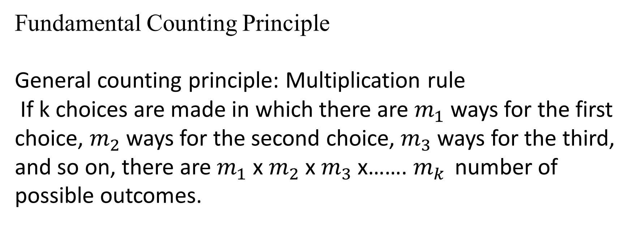
SENIOR HIGH SCHOOL DEPARTMENT
Fundamental Counting Principle
General counting principle: Multiplication rule
If k choices are made in which there are $m_{1}$ways for the first choice, $m_{2}$ways for the second choice, $m_{3}$ways for the third, and so on, there are $m_{1}$x $m_{2}$x $m_{3}$x……. $m_{k }$number of possible outcomes.
STATISTICS AND PROBABILITY
LODILYN D. MOGOL LPT. MAT MATH (CAR)

Slide 16
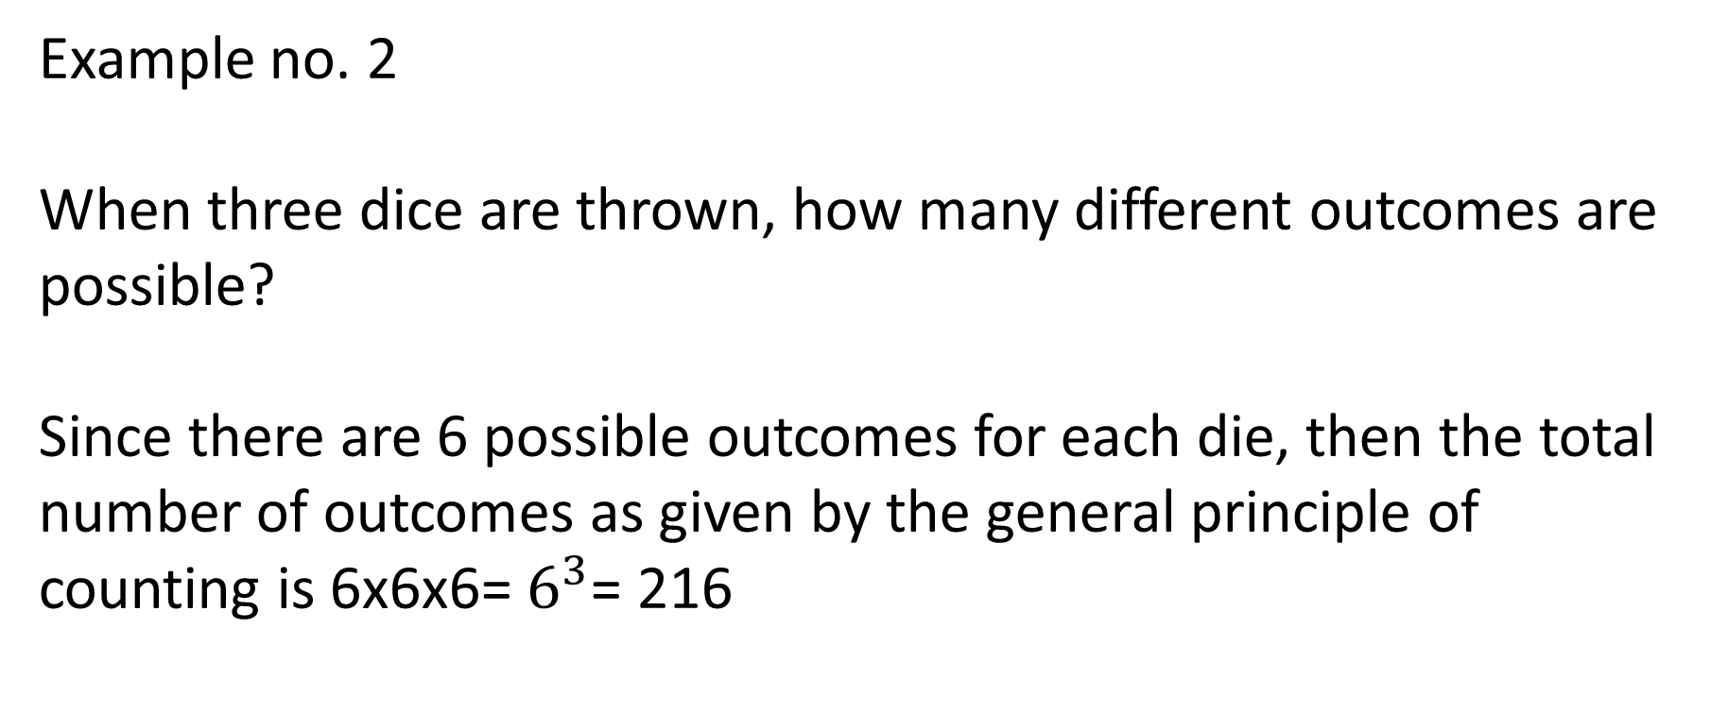
SENIOR HIGH SCHOOL DEPARTMENT
Example no. 2
When three dice are thrown, how many different outcomes are possible?
Since there are 6 possible outcomes for each die, then the total number of outcomes as given by the general principle of counting is 6x6x6= $6^{3}$= 216
STATISTICS AND PROBABILITY
LODILYN D. MOGOL LPT. MAT MATH (CAR)

Slide 17
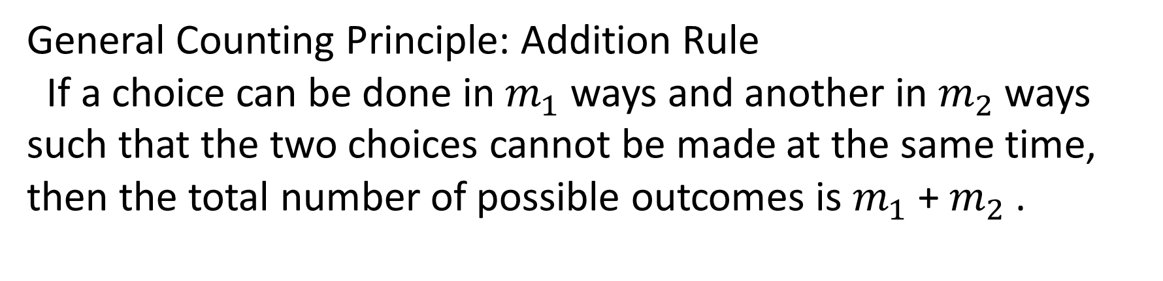
SENIOR HIGH SCHOOL DEPARTMENT
General Counting Principle: Addition Rule
If a choice can be done in $m_{1}$ways and another in $m_{2}$ways such that the two choices cannot be made at the same time, then the total number of possible outcomes is $m_{1}$+ $m_{2}$.
STATISTICS AND PROBABILITY
LODILYN D. MOGOL LPT. MAT MATH (CAR)

Slide 18
SENIOR HIGH SCHOOL DEPARTMENT
Example no. 3
A student, either a junior or a senior, is to be chosen as the school’s representative for an extemporaneous speech contest. If there are 50 juniors and 70 seniors, in how many ways can the selection be done?
Since only one student is to be chosen and it is technically impossible to have a student that is both a junior and a senior at the same time, by the addition rule, there are 50+70= 120 ways to choose a representative for the contest.
STATISTICS AND PROBABILITY
LODILYN D. MOGOL LPT. MAT MATH (CAR)

Slide 19
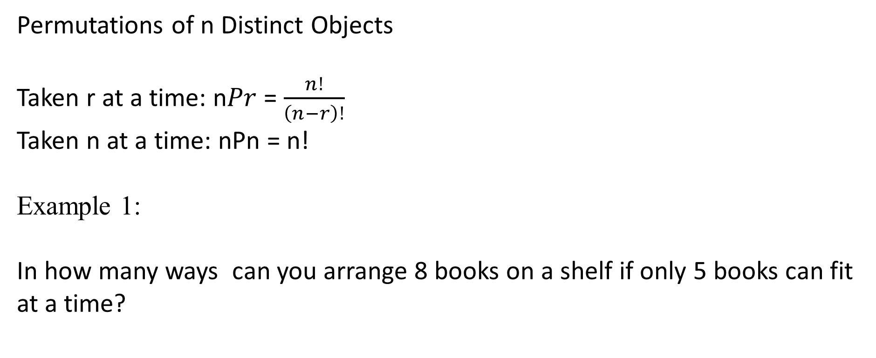
SENIOR HIGH SCHOOL DEPARTMENT
Permutations of n Distinct Objects
Taken r at a time: n$Pr$ = $\frac{n!}{\left(n−r\right)!}$
Taken n at a time: nPn = n!
Example 1:
In how many ways can you arrange 8 books on a shelf if only 5 books can fit at a time?
STATISTICS AND PROBABILITY
LODILYN D. MOGOL LPT. MAT MATH (CAR)

Slide 20
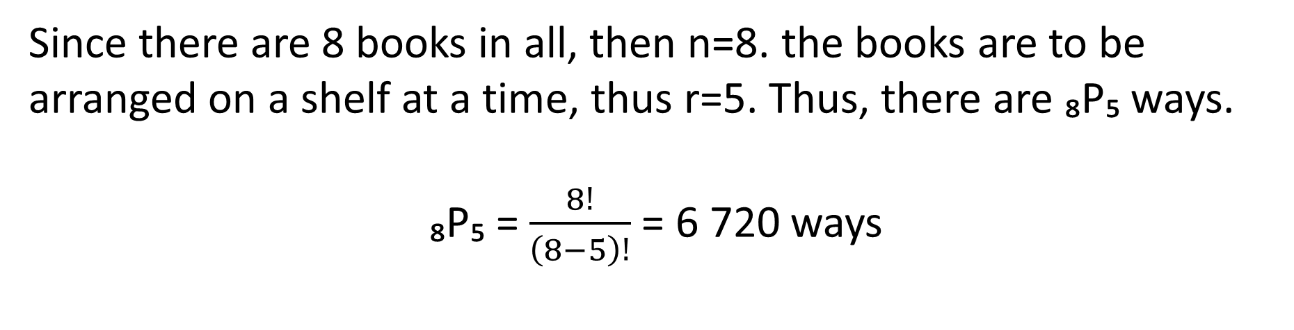
SENIOR HIGH SCHOOL DEPARTMENT
Since there are 8 books in all, then n=8. the books are to be arranged on a shelf at a time, thus r=5. Thus, there are ₈P₅ ways.
₈P₅ = $\frac{8!}{\left(8−5\right)!}$ = 6 720 ways
STATISTICS AND PROBABILITY
LODILYN D. MOGOL LPT. MAT MATH (CAR)

Slide 21
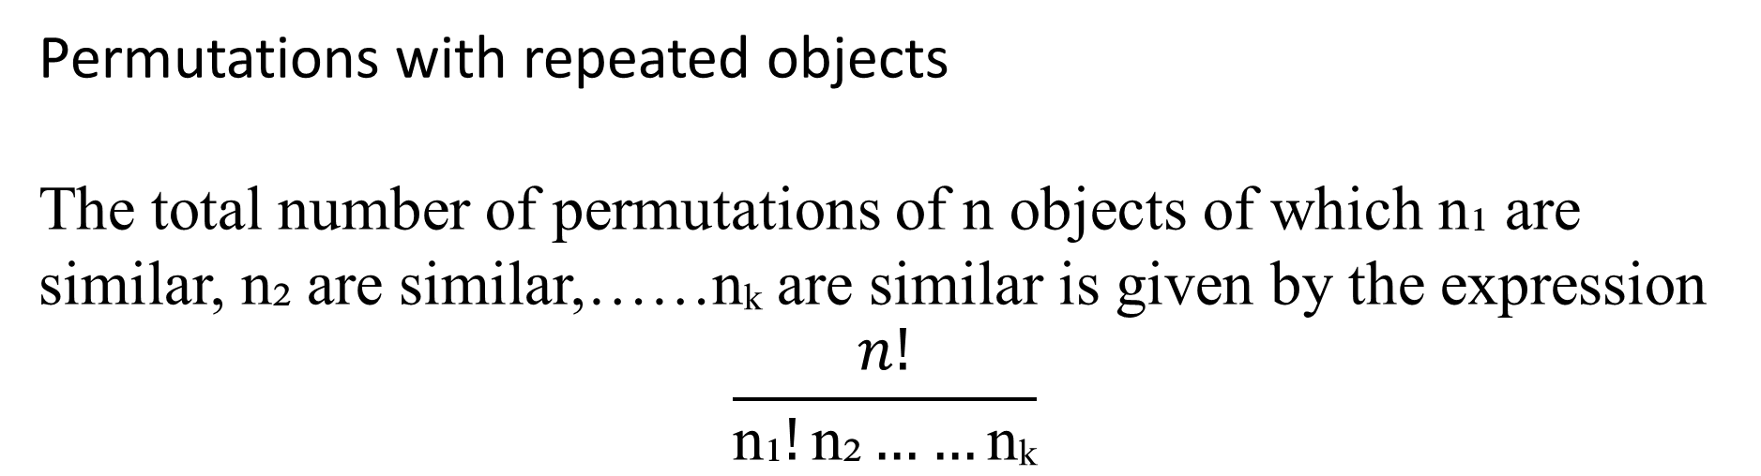
SENIOR HIGH SCHOOL DEPARTMENT
Permutations with repeated objects
The total number of permutations of n objects of which n₁ are similar, n₂ are similar,……nₖ are similar is given by the expression
$$\frac{n!}{\text{n}\text{₁}!\text{n}\text{₂}……\text{n}\text{ₖ}}$$
STATISTICS AND PROBABILITY
LODILYN D. MOGOL LPT. MAT MATH (CAR)

Slide 22
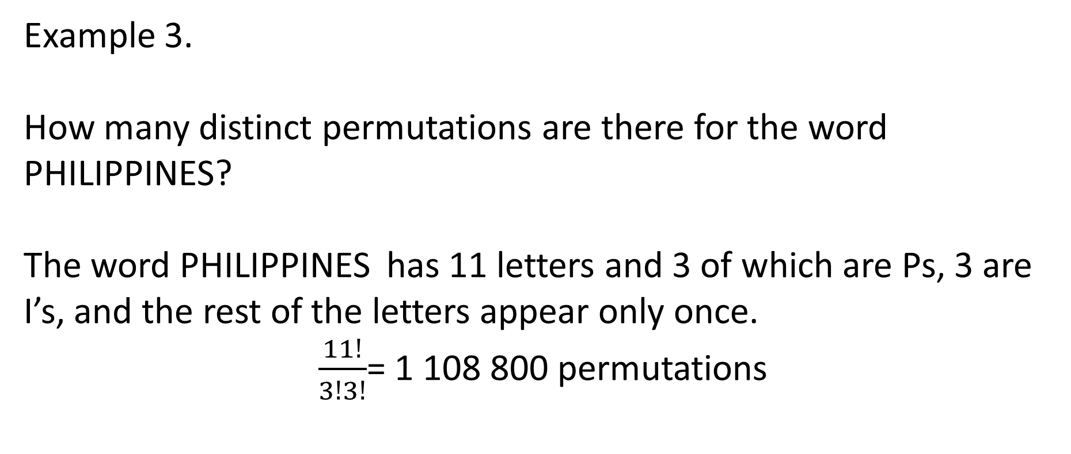
SENIOR HIGH SCHOOL DEPARTMENT
Example 3.
How many distinct permutations are there for the word PHILIPPINES?
The word PHILIPPINES has 11 letters and 3 of which are Ps, 3 are I’s, and the rest of the letters appear only once.
$\frac{11!}{3!3!}$= 1 108 800 permutations
STATISTICS AND PROBABILITY
LODILYN D. MOGOL LPT. MAT MATH (CAR)

Slide 23
SENIOR HIGH SCHOOL DEPARTMENT
Circular Permutation
If n objects are arranged in a circle, then there are a total of (n-1)! Permutations.
Example 4.
In how many ways can you sit 8 people in a round table with 8 seats?
(8-1)!= 7!= 5 040 ways
STATISTICS AND PROBABILITY
LODILYN D. MOGOL LPT. MAT MATH (CAR)

Slide 24
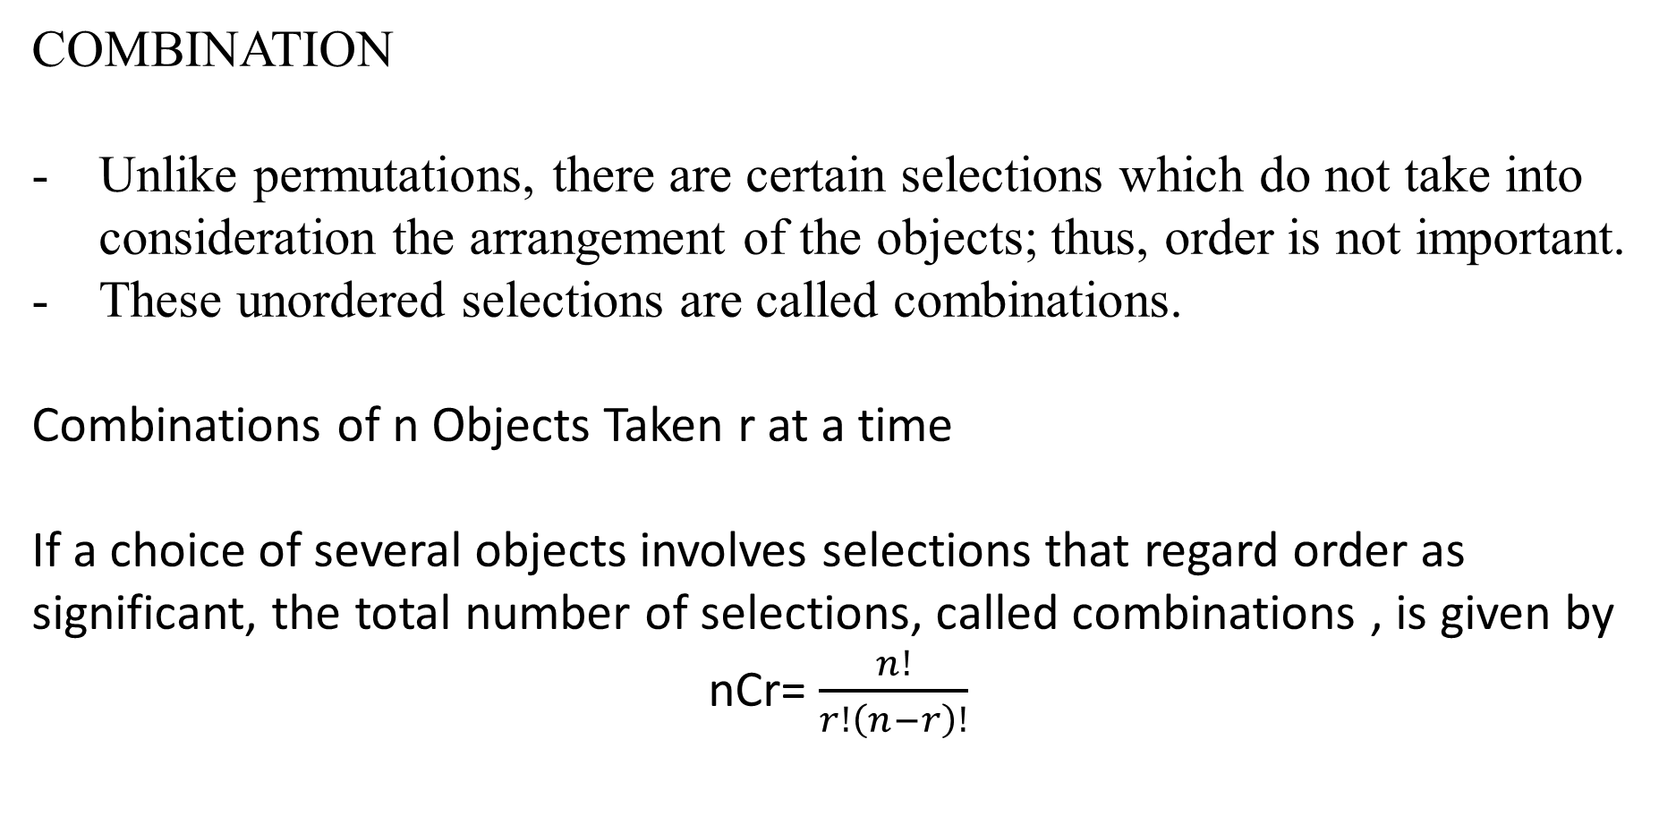
SENIOR HIGH SCHOOL DEPARTMENT
COMBINATION
Unlike permutations, there are certain selections which do not take into consideration the arrangement of the objects; thus, order is not important.
These unordered selections are called combinations.
Combinations of n Objects Taken r at a time
If a choice of several objects involves selections that regard order as significant, the total number of selections, called combinations , is given by
nCr= $\frac{n!}{r!\left(n−r\right)!}$
STATISTICS AND PROBABILITY
LODILYN D. MOGOL LPT. MAT MATH (CAR)

Slide 25
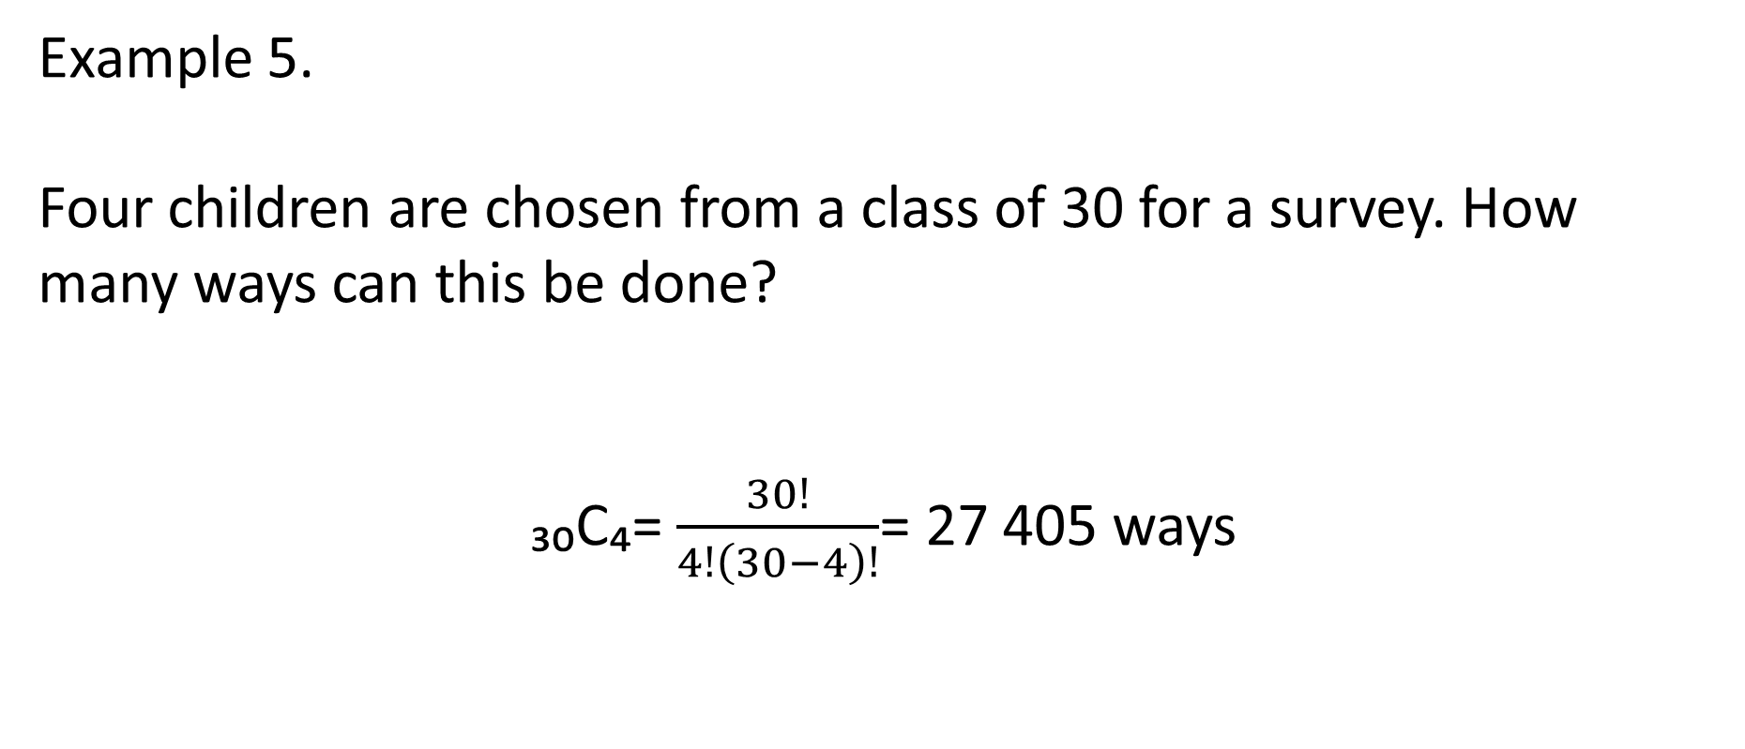
SENIOR HIGH SCHOOL DEPARTMENT
Example 5.
Four children are chosen from a class of 30 for a survey. How many ways can this be done?
₃₀C₄= $\frac{30!}{4!\left(30−4\right)!}$= 27 405 ways
STATISTICS AND PROBABILITY
LODILYN D. MOGOL LPT. MAT MATH (CAR)

Slide 26
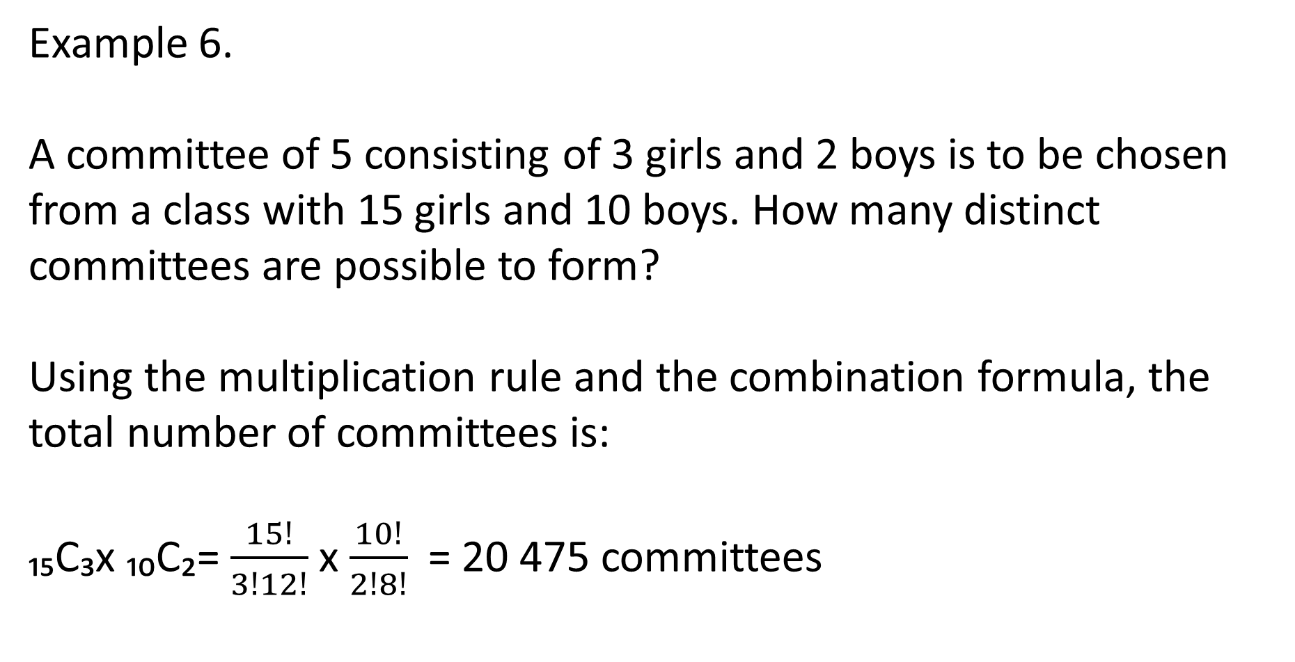
SENIOR HIGH SCHOOL DEPARTMENT
Example 6.
A committee of 5 consisting of 3 girls and 2 boys is to be chosen from a class with 15 girls and 10 boys. How many distinct committees are possible to form?
Using the multiplication rule and the combination formula, the total number of committees is:
₁₅C₃x ₁₀C₂= $\frac{15!}{3!12!}$ x $\frac{10!}{2!8!}$= 20 475 committees
STATISTICS AND PROBABILITY
LODILYN D. MOGOL LPT. MAT MATH (CAR)

Slide 27
SENIOR HIGH SCHOOL DEPARTMENT
ACTIVITY
STATISTICS AND PROBABILITY
LODILYN D. MOGOL LPT. MAT MATH (CAR)

Slide 28
SENIOR HIGH SCHOOL DEPARTMENT
Read and answer the following questions. Write your answer on a sheet of paper.
Students are classified according to gender (male or female), status (regular or irregular), and field of specialization (mathematics, physics, business, or languages). Draw a tree diagram to find all the possible classifications. Determine the total number of possible classifications of students.
Draw a tree diagram to show all possible outcomes when a pair of dice is rolled. How many outcomes are there?
STATISTICS AND PROBABILITY
LODILYN D. MOGOL LPT. MAT MATH (CAR)

Slide 29
SENIOR HIGH SCHOOL DEPARTMENT
Read and answer the following questions. Write your answers on a sheet of paper.
In how many ways can 6 beads be arranged in a string?
Find the distinct permutations of the word BARRACKS.
In how many ways can 8 algebra and 5 geometry books be arranged if the algebra books are arranged consecutively?
In how many ways can 7 trees be planted following a circular arrangement?
5. The coach of the winning basketball team chooses 3 of the 15 members to be interviewed by a sports reporter. In how many ways can the members to be interviewed be chosen?
STATISTICS AND PROBABILITY
LODILYN D. MOGOL LPT. MAT MATH (CAR)

